Slide 1



SRES’s
SHREE RAMCHANDRA COLLEGE OF ENGINEERING
Lonikand, Pune – 412216
Department of Computer Engineering
JSPM’s
Imperial College of Engineering and Research,Wagholi,Pune.
(Approved by AICTE,Delhi & Govt. of Maharashtra, affiliated to Savitribai Phule Pune University)
Gat.No.720,Pune-Nagar Road,Wagholi,Pune,412207
Department of Electronics and Telecommunication Engineering
A
Project Seminar On
“To Design ESP32- Driven System For Soil Health And
Climate Adaptive Irrigation Network Using Iot”
Under the Guidance of | Presented by
Prof. Mangala Biradar | 1) Vijay Beldar | (B400960083)
 | 2) Samyak Pandechari | (B400960119)
 | 3) Bhushan Salve | (B400960130)
 | 4) Soham Pawar | (B400960202)

Slide 2

SRES’s
SHREE RAMCHANDRA COLLEGE OF ENGINEERING
Lonikand, Pune – 412216
Department of Computer Engineering
JSPM’s
Imperial College of Engineering and Research,Wagholi,Pune.
(Approved by AICTE,Delhi & Govt. of Maharashtra, affiliated to Savitribai Phule Pune University)
Gat.No.720,Pune-Nagar Road,Wagholi,Pune,412207
Department of Electronics and Telecommunication Engineering
Index
Introduction of Project
Project Scope
Problem Statement
Objective
Literature Survey
Hardware Software Requirements
Project Design
Algorithm
Basic Details of Implementation
Proposed Outputs
Advantages & Disadvantages
Future Scope
Conclusion
Reference

Slide 3
SRES’s
SHREE RAMCHANDRA COLLEGE OF ENGINEERING
Lonikand, Pune – 412216
Department of Computer Engineering
Introduction
Agriculture plays a vital role in the economy, but water scarcity and improper irrigation are major challenges.
Traditional irrigation systems depend on manual control, leading to water wastage and inefficiency.
The IoT-based Smart Irrigation System automates water distribution using real-time sensor data.
The system ensures efficient water usage and reduces unnecessary irrigation.
Key components include ESP32, ESP32-CAM, NodeMCU, DHT11, YL-83 rain sensor, and SEN6 soil moisture sensor.
Data is transmitted through WiFi for real-time monitoring.
A Telegram bot allows remote control and system status updates.
JSPM’s
Imperial College of Engineering and Research,Wagholi,Pune.
(Approved by AICTE,Delhi & Govt. of Maharashtra, affiliated to Savitribai Phule Pune University)
Gat.No.720,Pune-Nagar Road,Wagholi,Pune,412207
Department of Electronics and Telecommunication Engineering

Slide 4
SRES’s
SHREE RAMCHANDRA COLLEGE OF ENGINEERING
Lonikand, Pune – 412216
Department of Computer Engineering
JSPM’s
Imperial College of Engineering and Research,Wagholi,Pune.
(Approved by AICTE,Delhi & Govt. of Maharashtra, affiliated to Savitribai Phule Pune University)
Gat.No.720,Pune-Nagar Road,Wagholi,Pune,412207
Department of Electronics and Telecommunication Engineering
Project Scope
Automated Irrigation:
The system automatically controls water supply based on real-time soil moisture, rain, and environmental conditions, ensuring efficient irrigation.
IoT-Based Monitoring:
Farmers can monitor sensor data and control the irrigation system remotely using the Telegram application from anywhere.
Multi-Sensor Integration:
The system uses soil moisture, temperature, humidity, and rain sensors to collect accurate field data for better decision-making.
Dual Mode Operation:
The system supports both manual and automatic modes, allowing flexible control based on user requirements.

Slide 5
SRES’s
SHREE RAMCHANDRA COLLEGE OF ENGINEERING
Lonikand, Pune – 412216
Department of Computer Engineering
JSPM’s
Imperial College of Engineering and Research,Wagholi,Pune.
(Approved by AICTE,Delhi & Govt. of Maharashtra, affiliated to Savitribai Phule Pune University)
Gat.No.720,Pune-Nagar Road,Wagholi,Pune,412207
Department of Electronics and Telecommunication Engineering
Wireless Communication:
All components communicate using WiFi, reducing wiring complexity and enabling real-time data transfer.
Scalable Design:
The system can be expanded to multiple farms by adding additional sensors and controller modules.
Cost-Effective Solution:
The use of affordable components makes the system suitable for small and medium-scale farmers.

Slide 6
SRES’s
SHREE RAMCHANDRA COLLEGE OF ENGINEERING
Lonikand, Pune – 412216
Department of Computer Engineering
Problem Statement
To Design ESP32-Driven System For Soil Health And Climate Adaptive Irrigation Network Using Iot
JSPM’s
Imperial College of Engineering and Research,Wagholi,Pune.
(Approved by AICTE,Delhi & Govt. of Maharashtra, affiliated to Savitribai Phule Pune University)
Gat.No.720,Pune-Nagar Road,Wagholi,Pune,412207
Department of Electronics and Telecommunication Engineering

Slide 7
SRES’s
SHREE RAMCHANDRA COLLEGE OF ENGINEERING
Lonikand, Pune – 412216
Department of Computer Engineering
Objective
▪ To design an IoT-based smart irrigation system that monitors soil moisture, temperature, and humidity in real-time.
▪ To automatically control water supply using a 5V water pump and solenoid valve based on sensor readings.
▪ To enable remote monitoring and manual control of irrigation through the Telegram bot.
▪ To optimize water usage and prevent over-irrigation, promoting sustainable agriculture practices.
▪ To provide a cost-effective and scalable solution for efficient soil and crop management in modern farming.
JSPM’s
Imperial College of Engineering and Research,Wagholi,Pune.
(Approved by AICTE,Delhi & Govt. of Maharashtra, affiliated to Savitribai Phule Pune University)
Gat.No.720,Pune-Nagar Road,Wagholi,Pune,412207
Department of Electronics and Telecommunication Engineering

Slide 8
SRES’s
SHREE RAMCHANDRA COLLEGE OF ENGINEERING
Lonikand, Pune – 412216
Department of Computer Engineering
JSPM’s
Imperial College of Engineering and Research,Wagholi,Pune.
(Approved by AICTE,Delhi & Govt. of Maharashtra, affiliated to Savitribai Phule Pune University)
Gat.No.720,Pune-Nagar Road,Wagholi,Pune,412207
Department of Electronics and Telecommunication Engineering
Literature Survey
Sr. No. | Author & Year | Title / Publication | Methods | Limitation
1 | A. Sharma et al. (2025) | YL-83 Rain Sensor for Smart Irrigation Systems | Reduces unnecessary irrigation and water wastage. | Detects only the presence of rain and cannot accurately measure rainfall intensity.
2 | Zvinodashe Feresu et al. (2022) | DHT11 Temperature and Humidity Sensor for IoT Monitoring Systems | Measures temperature and humidity in real time. | Has limited measurement accuracy and a slower response compared to advanced sensors.
3 | L. Yu et al. (2021) | Robodo SEN6 Soil Moisture Sensor for Smart Irrigation Systems | Supports automated irrigation based on soil conditions. | Sensor readings may vary due to soil type and require periodic calibration.
4 | Espressif Systems (2021) | ESP32-CAM Module for IoT-Based Monitoring Systems | Captures real-time images for remote field monitoring. | Image quality depends on lighting conditions and stable WiFi connectivity.
5 | Espressif Systems (2020) | ESP32 Microcontroller for IoT-Based Systems | Efficient for controlling multiple sensors and devices. | Limited GPIO pins and processing resources for large-scale IoT applications.
6 | Espressif Systems (2019) | NodeMCU (ESP8266) for IoT-Based Automation Systems | Provides built-in WiFi connectivity for IoT communication. | Supports only 2.4 GHz WiFi and has limited memory for complex applications.

Slide 9
SRES’s
SHREE RAMCHANDRA COLLEGE OF ENGINEERING
Lonikand, Pune – 412216
Department of Computer Engineering
JSPM’s
Imperial College of Engineering and Research,Wagholi,Pune.
(Approved by AICTE,Delhi & Govt. of Maharashtra, affiliated to Savitribai Phule Pune University)
Gat.No.720,Pune-Nagar Road,Wagholi,Pune,412207
Department of Electronics and Telecommunication Engineering
Hardware Software Requirements
Developer Side:
ESP32 Microcontroller for sensor interfacing and system control
Laptop/PC for coding, testing, and debugging
Arduino IDE for programming ESP32 and NodeMCU modules
Telegram Bot API for remote communication and control
Client Side (Field Setup):
  Soil Moisture Sensor for monitoring soil water levels
  DHT11 Sensor for temperature and humidity measurement
  Water Pump for irrigation control and water distribution
  Telegram App for remote monitoring and control
  WiFi Network for real-time communication and connectivity
  ESP32 Firmware for sensor data processing and automation

Slide 10
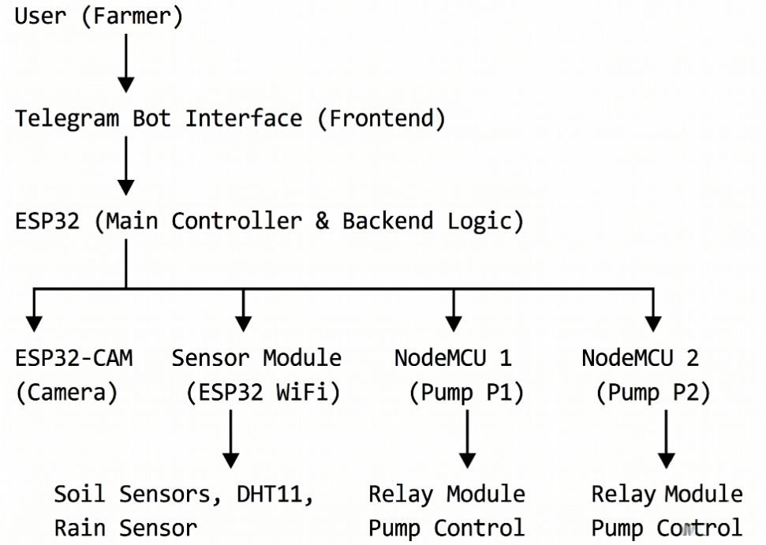
SRES’s
SHREE RAMCHANDRA COLLEGE OF ENGINEERING
Lonikand, Pune – 412216
Department of Computer Engineering
JSPM’s
Imperial College of Engineering and Research,Wagholi,Pune.
(Approved by AICTE,Delhi & Govt. of Maharashtra, affiliated to Savitribai Phule Pune University)
Gat.No.720,Pune-Nagar Road,Wagholi,Pune,412207
Department of Electronics and Telecommunication Engineering
Project Design
Fig.1 Project Architecture

Slide 11
SRES’s
SHREE RAMCHANDRA COLLEGE OF ENGINEERING
Lonikand, Pune – 412216
Department of Computer Engineering
User (Farmer): The farmer remotely monitors and controls the irrigation system using the Telegram bot.
Telegram Bot Interface (Frontend): The Telegram bot acts as the user interface for sending commands and receiving updates.
ESP32 (Main Controller & Backend Logic): The ESP32 processes sensor data and controls overall system operations.
ESP32-CAM (Camera): The ESP32-CAM captures real-time images of the agricultural field for monitoring.
Sensor Module (ESP32 WiFi): The sensor module collects environmental data such as soil moisture, temperature, humidity, and rainfall.
NodeMCU 1 (Pump P1): NodeMCU 1 controls the first water pump using a relay module. NodeMCU 2 (Pump P2): NodeMCU 2 controls the second water pump for irrigation management.
Soil Sensors, DHT11, Rain Sensor: These sensors provide real-time environmental and soil condition data.
Relay Module Pump Control: The relay modules switch the water pumps ON or OFF based on system commands.

Slide 12
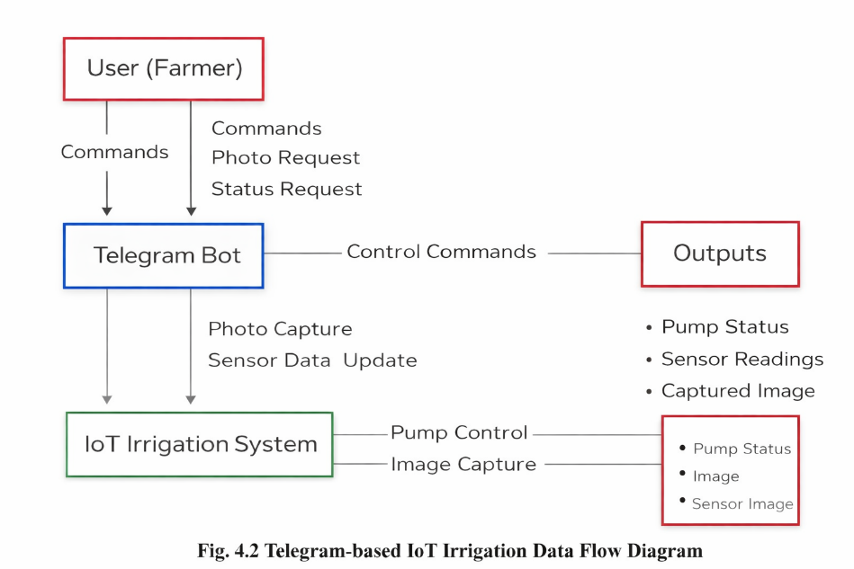
SRES’s
SHREE RAMCHANDRA COLLEGE OF ENGINEERING
Lonikand, Pune – 412216
Department of Computer Engineering
Fig.2 Data Flow

Slide 13
SRES’s
SHREE RAMCHANDRA COLLEGE OF ENGINEERING
Lonikand, Pune – 412216
Department of Computer Engineering
User (Farmer): The farmer sends commands and monitors the irrigation system remotely using the Telegram bot.
Commands: Commands are used to control pumps and switch between manual and automatic modes.
Photo Request: The user can request real-time field images through the Telegram bot.
Status Request: The user can check sensor readings and pump status at any time.
Telegram Bot: The Telegram bot acts as the communication interface between the user and the IoT system.
Control Commands: The Telegram bot sends user commands to the IoT irrigation system for processing.
IoT Irrigation System: The IoT system processes sensor data and controls irrigation operations automatically. Photo Capture: The system captures field images using the ESP32-CAM module when requested.

Slide 14
SRES’s
SHREE RAMCHANDRA COLLEGE OF ENGINEERING
Lonikand, Pune – 412216
Department of Computer Engineering
Sensor Data Update: Sensor readings are continuously updated and sent to the Telegram bot.
Pump Control: The system controls water pumps through NodeMCU and relay modules.
Image Capture: The ESP32-CAM captures and sends real-time field images for monitoring.
Outputs: The system provides outputs such as pump status, sensor readings, and captured images.
Pump Status: Displays whether the water pump is ON or OFF.
Sensor Readings: Shows soil moisture, temperature, humidity, and rain sensor values.
Captured Image: Provides a real-time image of the agricultural field for remote monitoring.

Slide 15
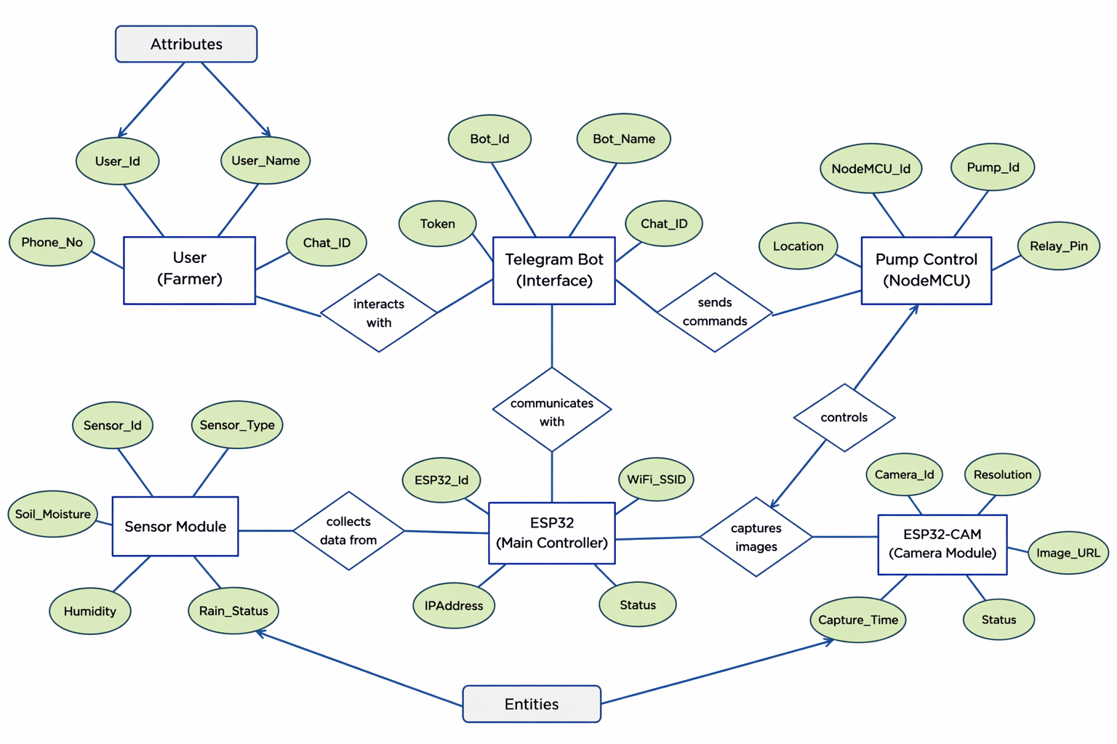
SRES’s
SHREE RAMCHANDRA COLLEGE OF ENGINEERING
Lonikand, Pune – 412216
Department of Computer Engineering
Fig.3 ER diagram

Slide 16
SRES’s
SHREE RAMCHANDRA COLLEGE OF ENGINEERING
Lonikand, Pune – 412216
Department of Computer Engineering
User (Farmer)
The user interacts with the system through the Telegram bot to control and monitor irrigation.
Telegram Bot
Acts as an interface that receives user commands and sends system responses.
ESP32 (Main Controller)
Processes sensor data and manages overall system operations and decision-making.
Sensor Module
Collects real-time environmental data such as soil moisture, temperature, humidity, and rainfall.
NodeMCU (Motor Control)
Controls water pumps using relay modules based on commands from ESP32.
ESP32-CAM
Captures real-time images of the field and sends them to the user.
Outputs
Displays system results including pump status, sensor readings, and captured images.

Slide 17
SRES’s
SHREE RAMCHANDRA COLLEGE OF ENGINEERING
Lonikand, Pune – 412216
Department of Computer Engineering
JSPM’s
Imperial College of Engineering and Research,Wagholi,Pune.
(Approved by AICTE,Delhi & Govt. of Maharashtra, affiliated to Savitribai Phule Pune University)
Gat.No.720,Pune-Nagar Road,Wagholi,Pune,412207
Department of Electronics and Telecommunication Engineering
Algorithm
Collect Sensor Data:
Read soil moisture values from both farms
Capture temperature and humidity using DHT11
Detect rainfall using rain sensor
    Analyze Irrigation Conditions:
Compare soil moisture with threshold values
Check rain status and environmental conditions
Decide whether irrigation is required or not
Execute Pump Control:
  ESP32 sends ON/OFF commands to NodeMCU modules
  Relay modules control water pumps automatically
  Pumps operate based on sensor conditions

Slide 18
JSPM’s
Imperial College of Engineering and Research,Wagholi,Pune.
(Approved by AICTE,Delhi & Govt. of Maharashtra, affiliated to Savitribai Phule Pune University)
Gat.No.720,Pune-Nagar Road,Wagholi,Pune,412207
Department of Electronics and Telecommunication Engineering
SRES’s
SHREE RAMCHANDRA COLLEGE OF ENGINEERING
Lonikand, Pune – 412216
Department of Computer Engineering
Manual Control via Telegram Bot:
User sends commands through Telegram bot
Manual mode overrides automatic operation
Pumps can be controlled remotely in real time
Send Status Updates:
Send sensor readings and motor status to user
Provide real-time notifications through Telegram
ESP32-CAM sends field images when requested

Slide 19
SRES’s
SHREE RAMCHANDRA COLLEGE OF ENGINEERING
Lonikand, Pune – 412216
Department of Computer Engineering
JSPM’s
Imperial College of Engineering and Research,Wagholi,Pune.
(Approved by AICTE,Delhi & Govt. of Maharashtra, affiliated to Savitribai Phule Pune University)
Gat.No.720,Pune-Nagar Road,Wagholi,Pune,412207
Department of Electronics and Telecommunication Engineering
Basic Details of Implementation
ESP32 as Core Controller:
ESP32 manages all sensors, relay modules, and IoT communication through Telegram Bot for real-time monitoring and control.
Sensor Integration:
Soil Moisture (SEN6), Rain (YL-83), and DHT11 sensors continuously collect soil and climate data to guide irrigation decisions.
Automated Irrigation Control:
Relay module activates the 5V water pump and solenoid valve based on sensor readings, ensuring precise and water-efficient irrigation.

Slide 20
SRES’s
SHREE RAMCHANDRA COLLEGE OF ENGINEERING
Lonikand, Pune – 412216
Department of Computer Engineering
JSPM’s
Imperial College of Engineering and Research,Wagholi,Pune.
(Approved by AICTE,Delhi & Govt. of Maharashtra, affiliated to Savitribai Phule Pune University)
Gat.No.720,Pune-Nagar Road,Wagholi,Pune,412207
Department of Electronics and Telecommunication Engineering
IoT and Cloud Connectivity:
Telegram app displays live sensor data and allows users to monitor, control, and receive alerts remotely from anywhere.
Smart Decision Logic:
The system compares real-time soil and weather data with preset thresholds to automatically start or stop irrigation.
Fail-Safe and Power Efficiency:
Operates even if Wi-Fi disconnects and enters low-power mode during stable conditions to save energy.

Slide 21
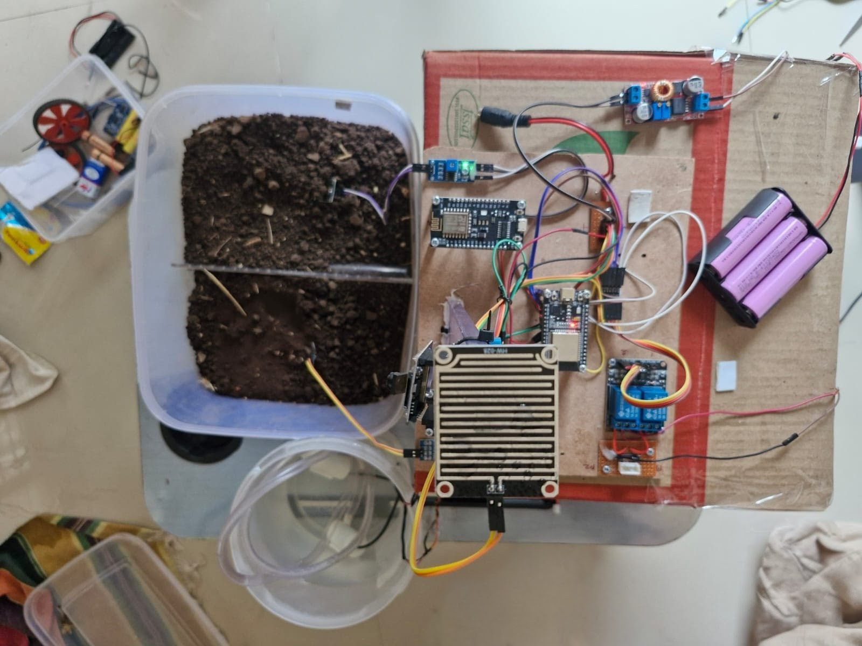
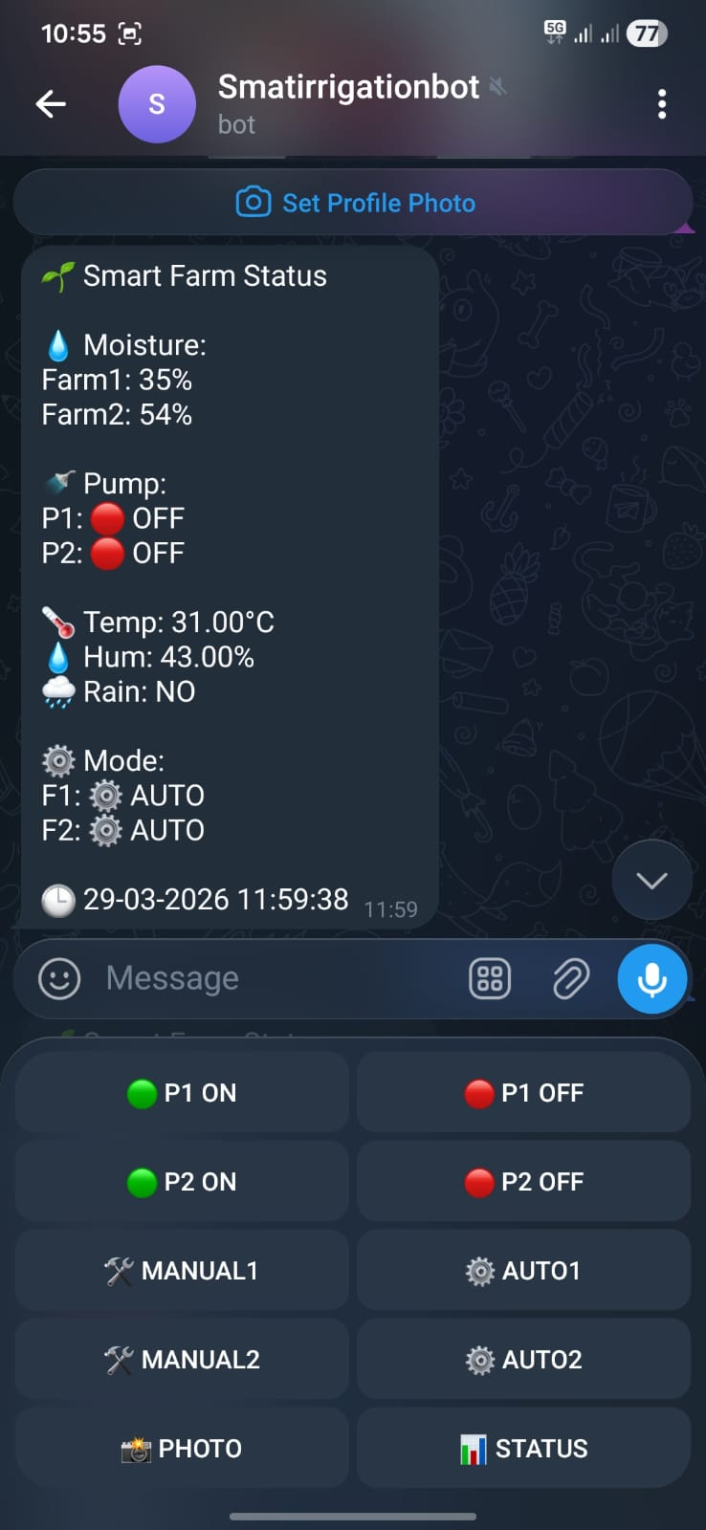
SRES’s
SHREE RAMCHANDRA COLLEGE OF ENGINEERING
Lonikand, Pune – 412216
Department of Computer Engineering
JSPM’s
Imperial College of Engineering and Research,Wagholi,Pune.
(Approved by AICTE,Delhi & Govt. of Maharashtra, affiliated to Savitribai Phule Pune University)
Gat.No.720,Pune-Nagar Road,Wagholi,Pune,412207
Department of Electronics and Telecommunication Engineering
OUTPUT
Fig.4 Project Deployment Setup
Fig.5 Telegram Operating Interface

Slide 22
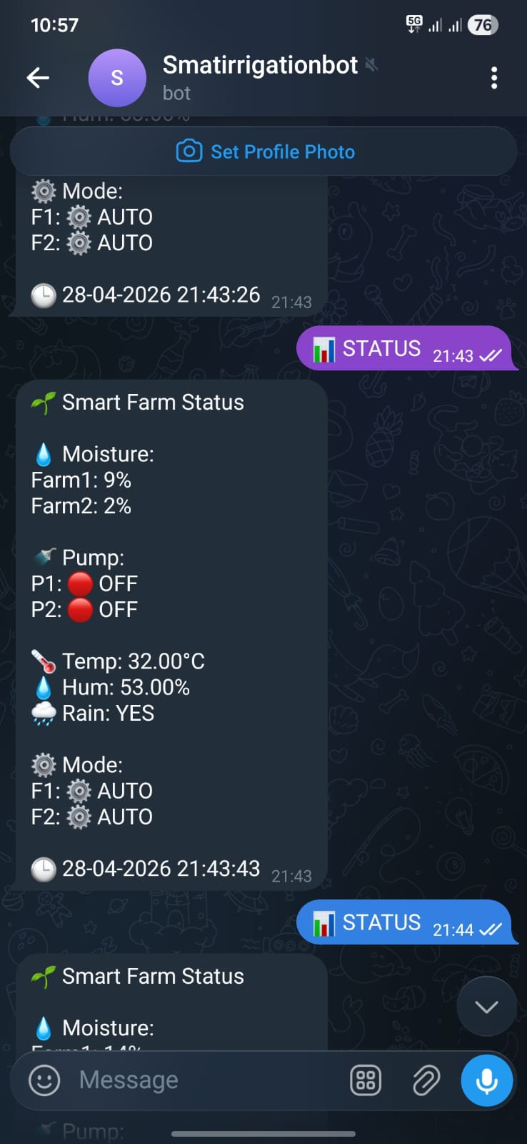
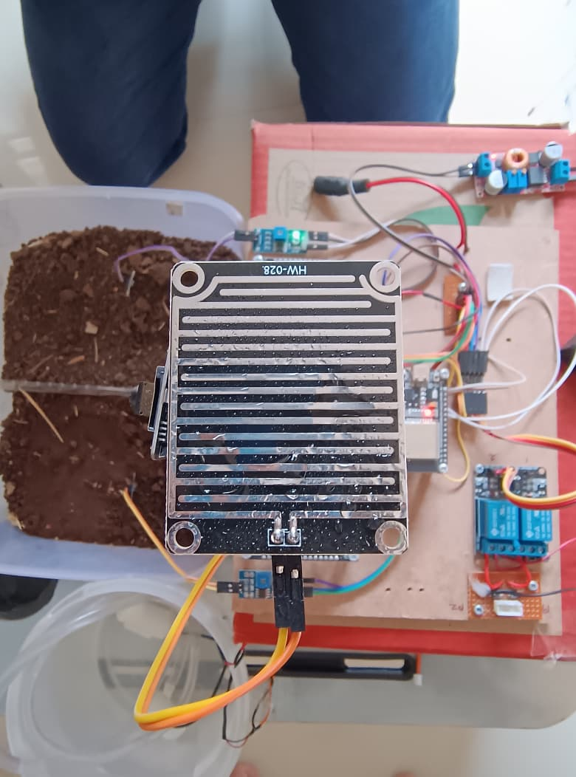
SRES’s
SHREE RAMCHANDRA COLLEGE OF ENGINEERING
Lonikand, Pune – 412216
Department of Computer Engineering
Fig.6 Rain Sensor
Fig.7 Rain Status

Slide 23
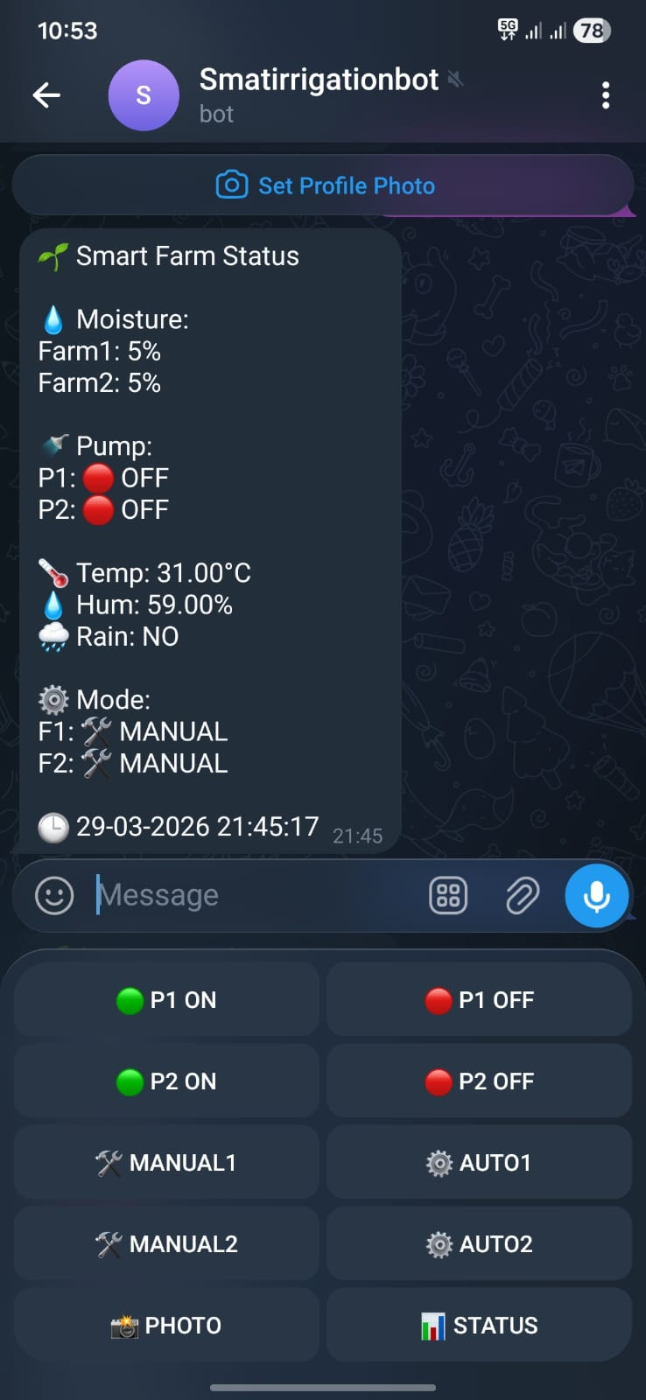
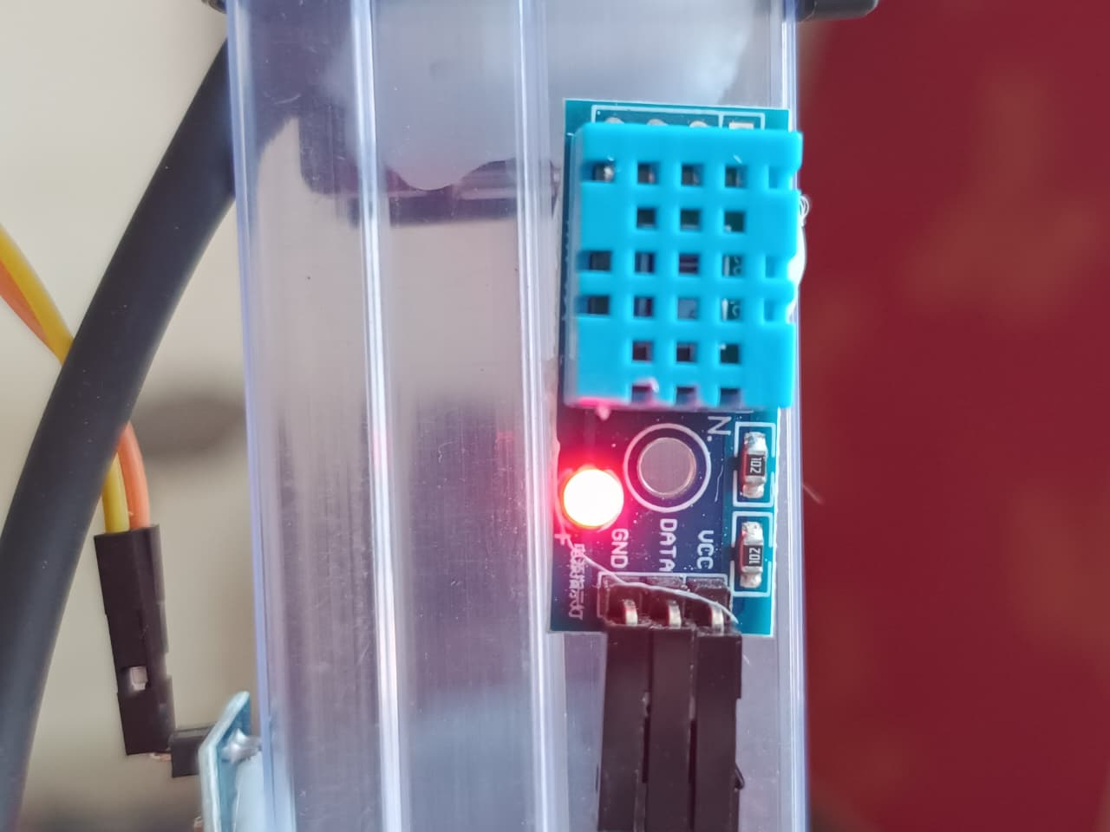
SRES’s
SHREE RAMCHANDRA COLLEGE OF ENGINEERING
Lonikand, Pune – 412216
Department of Computer Engineering
Fig.8 Temperature And Humidity Sensor
Fig.9 Temperature And Humidity Status

Slide 24
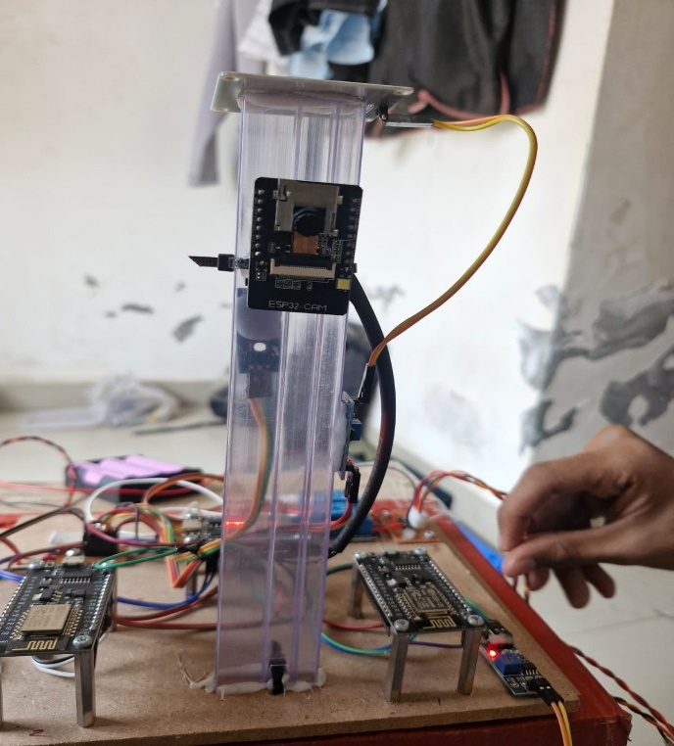
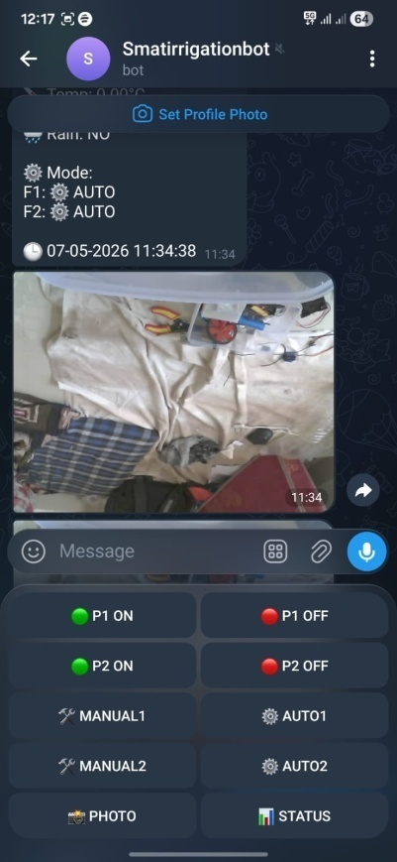
SRES’s
SHREE RAMCHANDRA COLLEGE OF ENGINEERING
Lonikand, Pune – 412216
Department of Computer Engineering
Fig.10 Esp-32 Cam Sensor
Fig.11 Camera Status

Slide 25
SRES’s
SHREE RAMCHANDRA COLLEGE OF ENGINEERING
Lonikand, Pune – 412216
Department of Computer Engineering
JSPM’s
Imperial College of Engineering and Research,Wagholi,Pune.
(Approved by AICTE,Delhi & Govt. of Maharashtra, affiliated to Savitribai Phule Pune University)
Gat.No.720,Pune-Nagar Road,Wagholi,Pune,412207
Department of Electronics and Telecommunication Engineering
ADVANTAGES & DISADVANTAGES
Advantages:
Enables automatic irrigation based on real-time soil and climate conditions.
Reduces water wastage and improves water management efficiency.
Allows remote monitoring and control through the Telegram bot.
Provides real-time field images and environmental data for better decision-making.
Disadvantages:
Requires stable WiFi and internet connectivity for proper operation.
Sensor readings may be affected by environmental conditions and calibration errors.
Initial setup and configuration require technical knowledge.
System performance depends on continuous power supply availability.

Slide 26
SRES’s
SHREE RAMCHANDRA COLLEGE OF ENGINEERING
Lonikand, Pune – 412216
Department of Computer Engineering
JSPM’s
Imperial College of Engineering and Research,Wagholi,Pune.
(Approved by AICTE,Delhi & Govt. of Maharashtra, affiliated to Savitribai Phule Pune University)
Gat.No.720,Pune-Nagar Road,Wagholi,Pune,412207
Department of Electronics and Telecommunication Engineering
FUTURE SCOPE
Cloud Data Storage and Analytics
Sensor data can be stored on cloud platforms for long-term monitoring, analysis, and crop performance prediction.
Solar-Powered Irrigation System
Solar panels can be integrated to power ESP32 modules, sensors, and water pumps. This will reduce electricity costs and make the system environmentally friendly.
Automatic Water Level Protection
A water level sensor can automatically stop the motor when the storage tank is empty, preventing pump damage and saving energy.

Slide 27
SRES’s
SHREE RAMCHANDRA COLLEGE OF ENGINEERING
Lonikand, Pune – 412216
Department of Computer Engineering
CONCLUSION
The IoT-based smart irrigation system improves water management using real-time sensor monitoring and automation.
ESP32 and Telegram integration enable remote monitoring and efficient pump control.
The system reduces water wastage, human effort, and operational costs.
It supports sustainable farming and improves irrigation efficiency.
Overall, it provides a reliable, scalable, and cost-effective smart agriculture solution.
JSPM’s
Imperial College of Engineering and Research,Wagholi,Pune.
(Approved by AICTE,Delhi & Govt. of Maharashtra, affiliated to Savitribai Phule Pune University)
Gat.No.720,Pune-Nagar Road,Wagholi,Pune,412207
Department of Electronics and Telecommunication Engineering

Slide 28
SRES’s
SHREE RAMCHANDRA COLLEGE OF ENGINEERING
Lonikand, Pune – 412216
Department of Computer Engineering
JSPM’s
Imperial College of Engineering and Research,Wagholi,Pune.
(Approved by AICTE,Delhi & Govt. of Maharashtra, affiliated to Savitribai Phule Pune University)
Gat.No.720,Pune-Nagar Road,Wagholi,Pune,412207
Department of Electronics and Telecommunication Engineering
REFERENCE
Yu, L., Gao, W., & Shamshiri, R. R. (2021). Review of Research Progress on Soil Moisture Sensor Technology. International Journal of Agricultural and Biological Engineering (IJABE).
Sharma, A., et al. (2025). YL-83 Rain Detection Sensor Module for IoT Applications. International Journal of Advanced Research in Science, Communication and Technology.
Feresu, Z., Mashonjowa, E., & Matandirotya, E. (2022). Performance Evaluation of DHT11 Temperature and Humidity Sensor for IoT Weather Systems. Journal of Electrical Engineering & Electronic Technology.
Espressif Systems. (2020). ESP32 Microcontroller – Technical Overview and IoT Applications.
Espressif Systems. (2019). NodeMCU (ESP8266) Development Board – Technical Reference.
Espressif Systems. (2021). ESP32-CAM Module – Camera-Based IoT System Datasheet

Slide 29
SRES’s
SHREE RAMCHANDRA COLLEGE OF ENGINEERING
Lonikand, Pune – 412216
Department of Computer Engineering
JSPM’s
Imperial College of Engineering and Research,Wagholi,Pune.
(Approved by AICTE,Delhi & Govt. of Maharashtra, affiliated to Savitribai Phule Pune University)
Gat.No.720,Pune-Nagar Road,Wagholi,Pune,412207
Department of Electronics and Telecommunication Engineering
Thank You!!!

